Slide 1
Data Management Planning
Data Sharing
Data Management Planning

Slide 2
What is data sharing?
  “… the practice of making data used for scholarly
  research available to others.” [Wikipedia]
Who’s involved?
  the data sharer
  the data repository
  the secondary data user
  support staff
  research participants
  commercial partners

Slide 3

Reasons to share data
BENEFITS
Avoid duplication
Scientific integrity
More collaboration
Better research
Increased citation
9-30% increase shown in
study
(Piwowar H. and Vision T.J 2013 , https://peerj.com/preprints/1.pdf)
DRIVERS
Public expectations
Government agenda
RCUK Data Policy
  www.rcuk.ac.uk/research/Pages/DataPolicy.aspx
UKRIO Code of Practice for Research
  www.ukrio.org/what-we-do/code-of-practice-for-research/

Slide 4
Managing restrictions on sharing
  Ethics
  Balance data protection with data sharing
  Informed consent – cover current and future use
  Confidentiality – is anonymisation appropriate?
  Access control – who, what, when?
  IPR
  Clarify copyright before research starts
  Consider licensing options e.g. Creative Commons

Slide 5

Select formats for data sharing
It’s better to use formats that are:
Unencrypted
Uncompressed
Non-proprietary/patent-encumbered
Open, documented standard
Standard representation (ASCII, Unicode)
Research360
Type | Recommended | Avoid for data sharing
Tabular data | CSV, TSV, SPSS portable | Excel
Text | Plain text, HTML, RTF PDF/A only if layout matters | Word
Media | Container: MP4, Ogg Codec: Theora, Dirac, FLAC | Quicktime H264
Images | TIFF, JPEG2000, PNG | GIF, JPG
Structured data | XML, RDF | RDBMS
Further examples: http://www.data-archive.ac.uk/create-manage/format/formats-table

Slide 6
How to share research data
Use appropriate repositories and data catalogues
  http://databib.org
  http://www.re3data.org/
  Jisc/DCC research data registry (coming soon!)
License the data so it is clear how it can be reused
  www.dcc.ac.uk/resources/how-guides/license-research-data
Make sure it’s clear how to cite the data
  http://www.dcc.ac.uk/resources/how-guides/cite-datasets
Consider publishing a data paper based on your DMP http://metajnl.com/

Slide 7
Data Management Planning

Slide 8
What is a DMP?
A short plan that outlines
what data you will create and how
how you will manage it
(storage, back-up, access…)
plans for data sharing and preservation
DMPs are often submitted as part of grant applications, but are useful whenever you’re creating data.
Create
Document
Use
Share
Preserve
Store

Slide 9
Why develop a DMP?
to help you manage your data
to provide guidelines for everyone to work to
to anticipate and avoid problems e.g. data loss
to avoid duplication, data loss & security breaches
to comply with funders requirements...

Slide 10
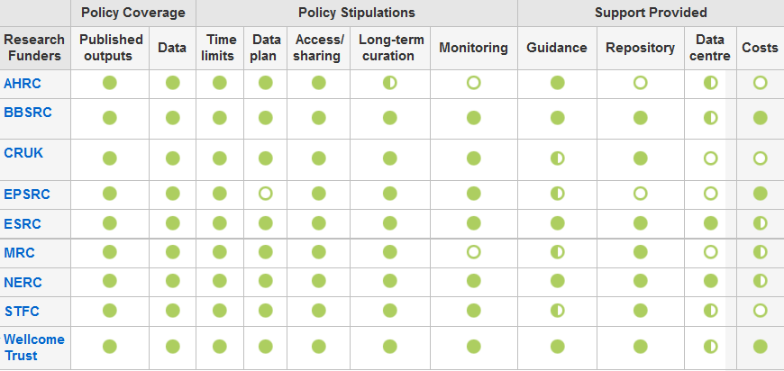
Research funders have DMP requirements
www.dcc.ac.uk/resources/policy-and-legal/overview-funders-data-policies

Slide 11
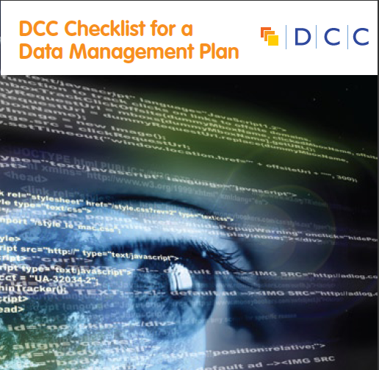
They typically want a short (c.1-2pp) statement covering:
  What data will be created (format, types, volume...)
  Standards and methodologies to be used (incl. metadata)
  How ethics and Intellectual Property will be addressed
  Plans for data sharing and access
  Strategy for long-term preservation

Slide 12


Data sharing plan
Covering:
Dataset
Standards
Metadata
Preservation
Data sharing
  method
  timescale
  restrictions
  agreements
Data Mgmt Plan
Covering:
Data
Data sharing
  when?
  where?
  how?
  restrictions?
Preservation
Resources
Data Mgmt Plan
Covering:
Data
Data collection
Management
Security
Data sharing
Responsibilities
Related policies
Admin details

Slide 13

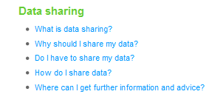
Some funders don’t ask for a DMP but still have expectations
Researchers applying for an HTA grant should consider data sharing in their proposals
Don’t prescribe sharing but expect researchers to consider and plan for it as appropriate
Follow DOH Research Governance Framework and MRC guidelines for Good Research Practice
www.hta.ac.uk/funding/troubleshooting/index.html
Notes:
In the FAQs for the Health Technology Assessment Programme, NHS clarifies that...

Slide 14
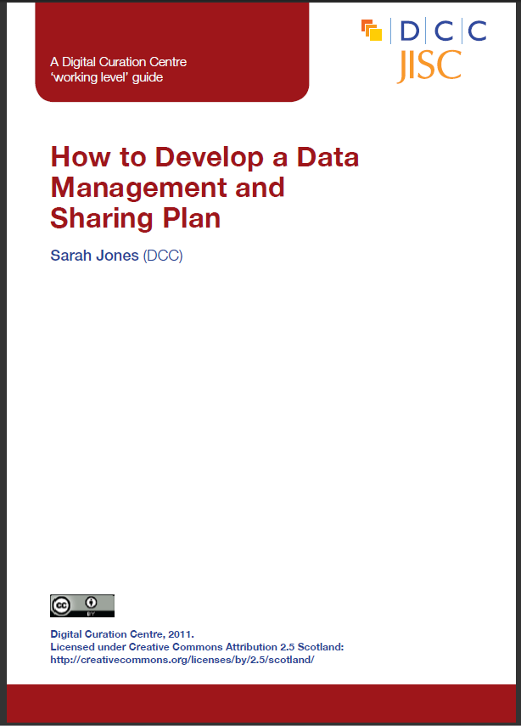

The DCC offers DMP guidance and tools
www.dcc.ac.uk/resources/data-management-plans

Slide 15
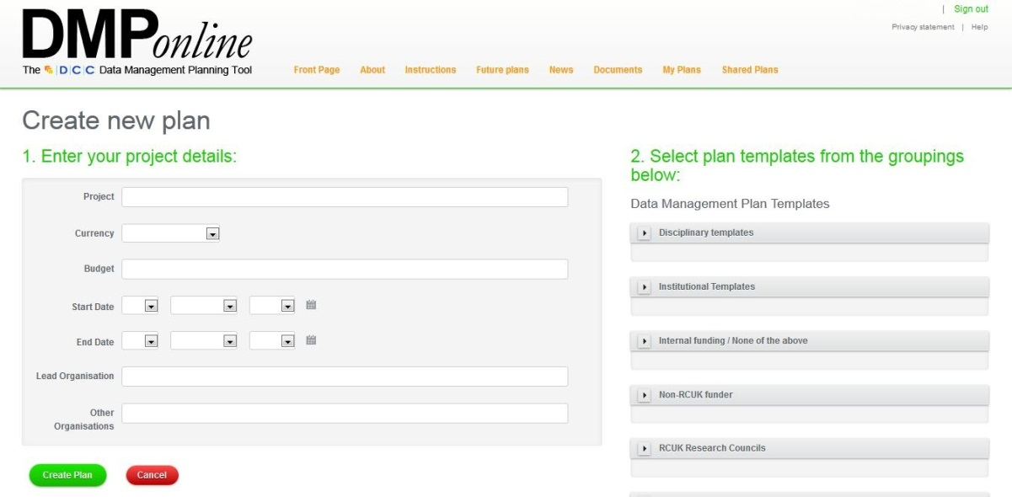
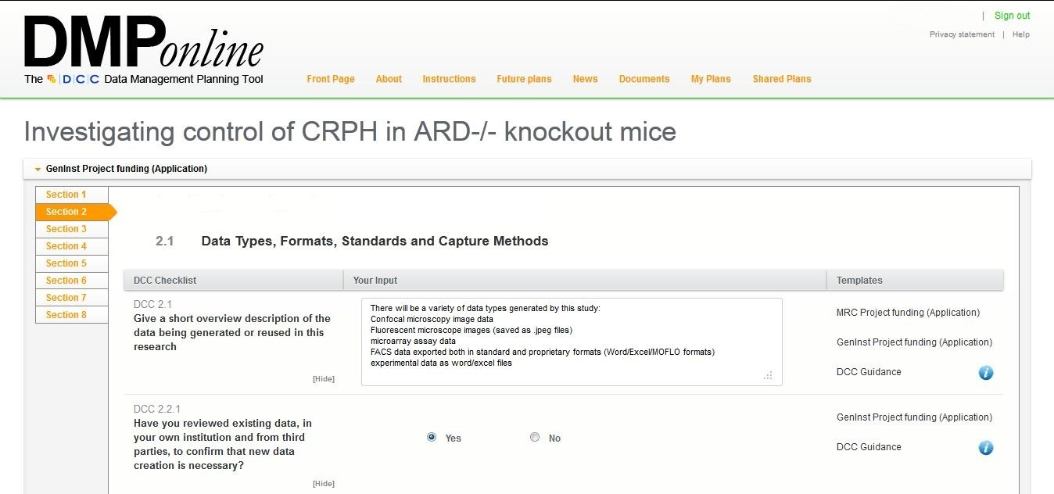
How DMPonline works
Create a plan based on relevant funder / institutional templates...
...and then answer the questions using the guidance provided

Slide 16
MRC advice on writing plans
What to include in a DMP for the MRC
    http://www.youtube.com/watch?v=ukVHHKp6sck&feature=c4-overview&list=UULTOHF6qQrYhEvQzbu03tTg
Advice on writing plans
http://www.youtube.com/watch?v=7OJtiA53-Fk&feature=c4-overview&list=UULTOHF6qQrYhEvQzbu03tTg
Including costs in DMPs
http://www.youtube.com/watch?v=nKeVPpupsYI&feature=c4-overview&list=UULTOHF6qQrYhEvQzbu03tTg

Slide 17
Tips for writing DMPs
  Start early - don’t wait until the last minute to plan!
  Don’t write the plan in isolation - seek advice from colleagues, ethics, IT, library, DP/FoI...
  Be realistic - base plans on available skills & support
  The plan will - and should - change over life of project
  Use plan as a communication tool with partners, funders and yourself!

